Slide 1

KS3 Mathematics
N1 Ordering Decimals
Notes:
The aim of this unit is to teach pupils to:
Understand and use decimal notation and place value; multiply and divide integers and decimals by powers of 10.
Compare and order decimals.
Round numbers, including to a given number of decimal places or significant figures.
Material in this unit is linked to the Key Stage 3 Framework supplement of examples pp 36-39.

Slide 2

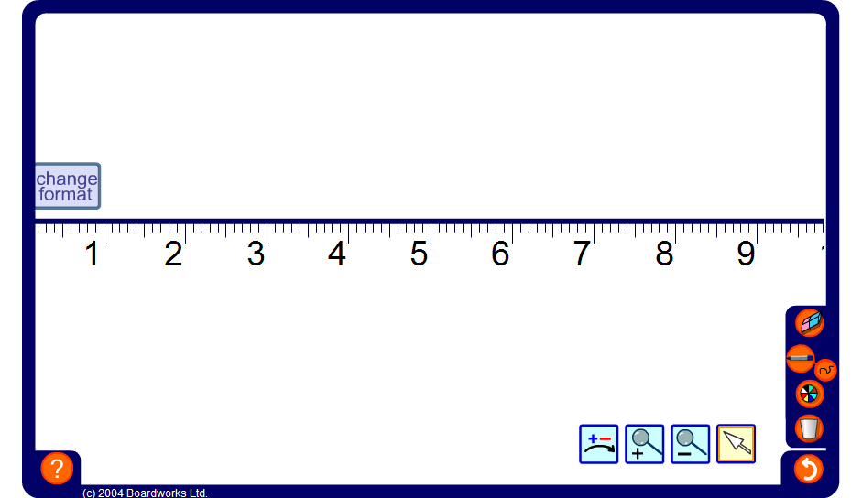


Zooming in on a number line
Notes:
Spend some time zooming in and out of the number line to demonstrate decimals on a number line.
Start by using the zoom in tool to select the area between two whole numbers, for example 1 and 2. Ask pupils to tell you the value of a decimal that would lie between any two given divisions, and zoom in to check.
Establish that by allowing decimals to any number of decimal places, an infinite number of decimals lie between any two given divisions; however many we have found, we can always find at least one more.
Extend the activity by zooming in to show numbers to more decimal places.

Slide 3

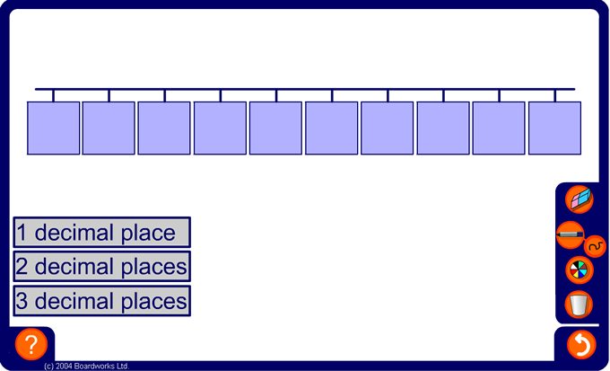
Decimal sequences
Notes:
The aim of this activity is to ensure that the pupils understand the positions of decimal numbers on a number line and that they are able to add (and subtract) small multiples of 0.1, 0.01 and 0.001 from decimals.
Start the activity by first establishing the size of the steps between each number. Ask pupils to tell you the values of the missing numbers (it is not necessary to do these in order). Press on an empty cell to reveal the number inside it.
Press on the number of decimal places required will generate a new number line.
Link:
A4 Sequences – continuing sequences.

Slide 4
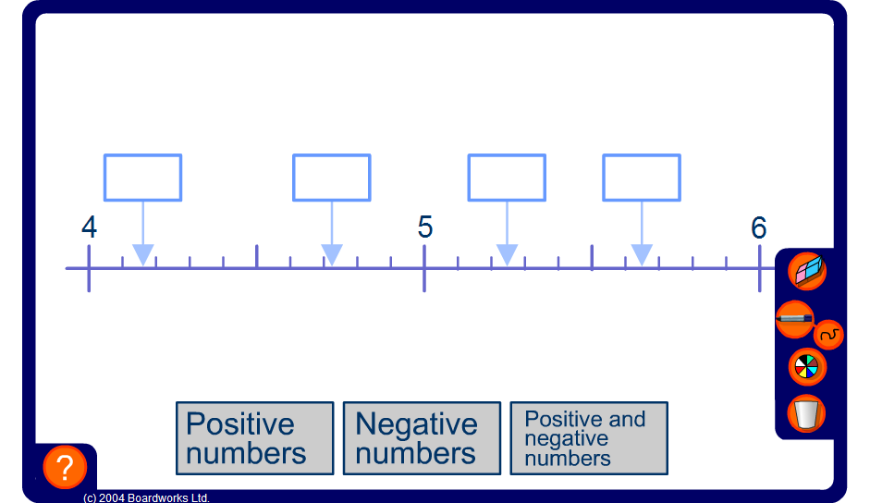
Decimals on a number line
Notes:
The aim of this activity is to help pupils to visualize the positions of decimal numbers on a number line and to estimate the size of decimals between two others by looking at the next decimal place. Click on an empty box to reveal the number inside it.
Differentiate the activity by including positive and negative decimals.

Slide 5
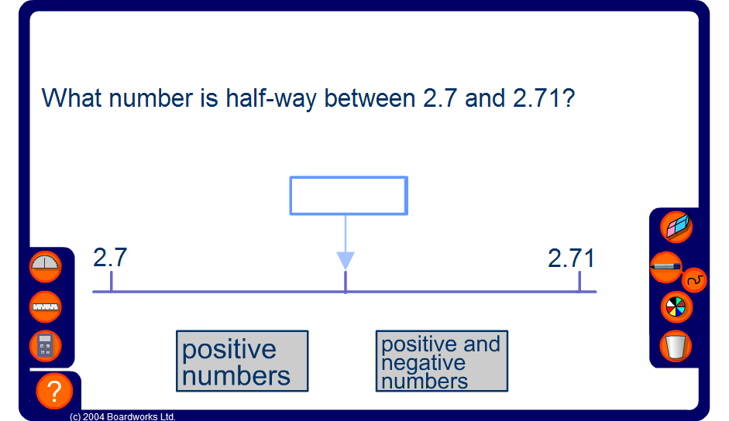
Mid-points
Notes:
This activity focuses on finding the mid-point between two numbers by looking at the next decimal place.
For more difficult examples encourage pupils to deduce that a mid-point can be found by adding the two end points and dividing by two. Discuss why this works, referring to the mean.
Extend the activity by using negative numbers; and by finding the mid-point between a negative and a positive number.
Link:
D3 Representing and interpreting data – calculating the mean

Slide 6
Comparing decimals
Which number is bigger:
1.72 or 1.702?
To compare two decimal numbers, look at each digit in order from left to right:
1 . 7 2
1 . 7 2
1 . 7 2
1 . 7 0 2
1 . 7 0 2
1 . 7 0 2
The 2 is bigger than the 0 so:
These digits are the same.
These digits are the same.
1.72 > 1.702
Notes:
Explain that to compare two decimals we must look at digits in the same position starting from the left. Explain that the digit furthest to the left is the most significant digit.
Talk through the example on the board:
Both numbers have 1 unit, so that doesn’t help.
Both numbers have 7 tenths, so that doesn’t help either.
The first number has 2 hundredths and the second number has no hundredths.
1.72 must therefore be bigger than 1.702.
Some pupils may need reminding of the meaning of the ‘greater than’ symbol.

Slide 7
Comparing decimals
Which measurement is bigger:
5.36 kg or 5371 g?
To compare two measurements, first write both measurements using the same units.
We can convert the grams to kilograms by dividing by 1000:
5371 g = 5.371 kg
Notes:
Stress that to compare measurements we must convert them to the same units.
Ask pupils how to convert grams to kilograms before revealing this on the board.
Point out that we also have chosen to convert both units to grams to compare the measurements.

Slide 8
Comparing decimals
Which measurement is bigger:
5.36 kg or 5.371 kg?
Next, compare the two decimal numbers by looking at each digit in order from left to right:
5 . 3 6
5 . 3 6
5 . 3 6
5 . 3 7 1
5 . 3 7 1
5 . 3 7 1
The 7 is bigger than the 6 so:
These digits are the same.
These digits are the same.
5.36 < 5.371

Slide 9
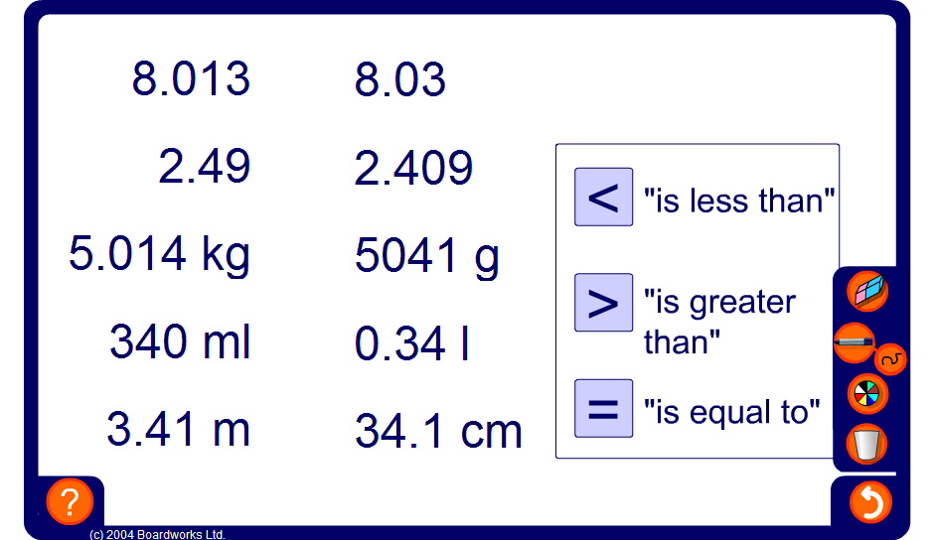
Comparing decimals
Notes:
Drag and drop the correct sign into place. Remind pupils that for the ‘greater than’ and ‘less than’ symbols the open end faces towards the larger number.
You may need to remind pupils of the unit conversions:
There are 1000 grams in a kilogram.
There are 1000 millilitres in a litre.
There are 100 centimetres in a metre.

Slide 10
Ordering decimals
Write these decimals in order from smallest to largest:
4.67
4.67
4.67
4.67
4.717
4.717
4.717
4.717
4.717
4.77
4.77
4.77
4.77
4.77
4.73
4.73
4.73
4.73
4.73
4.7
4.70
4.7
4.7
4.7
4.07
4.07
4.07
4.07
The correct order is:
To order these decimals we must compare the digits in the same position, starting from the left.
The digits in the unit positions are the same, so this does not help.
4.07
4.67
4.7
4.717
4.73
4.77
Looking at the first decimal place tells us that 4.07 is the smallest followed by 4.67
Looking at the second decimal place of the remaining numbers tells us that 4.7 is the smallest followed by 4.717, 4.73 and 4.77.
Notes:
Start by emphasising that, unlike whole numbers, we cannot order decimal numbers by looking at the number of digits in the number. We need to look at the digits in the same position starting from the left.
In this example all of the numbers start with a 4 in the unit position, so that does not help us. We need to look at the next digit in each number.
Talk through each point of the slide. We can write a zero in the second decimal place of 4.7 to help compare them. Point out that this zero does not change the number’s value.

Slide 11
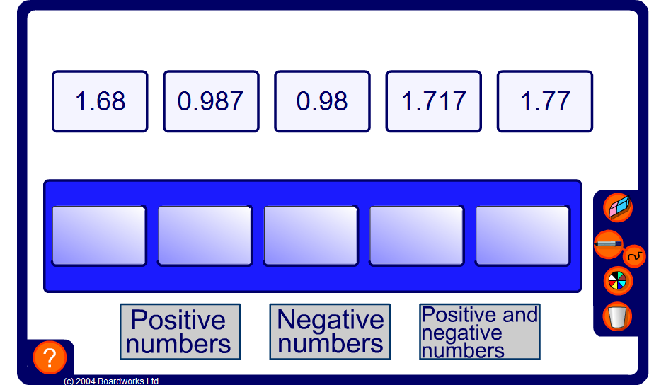
Ordering decimals
Notes:
Drag and drop each card underneath in order according to suggestions from pupils. Compare units, tenths, hundredths and thousandths in turn.
Ensure that the concept of working from the left until you find the highest digit is understood.

Slide 12
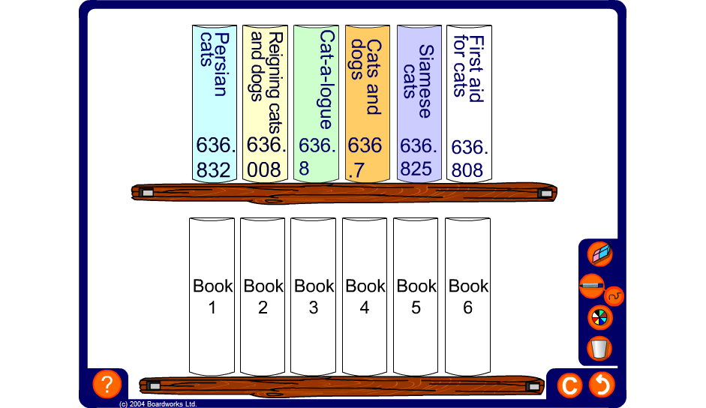
Dewey Decimal Classification System
Notes:
Practice the method for ordering decimals by completing the following activity:
Claire has been doing a project on cats and returns her books to the library. Help Mrs Hooper the librarian to put the books in the correct order using the Dewey Decimal Classification System.
In the 1870s Melvil Dewey invented a system of classifying library books on different subjects to make them easy to find. Each code has a three-digit whole number followed by a decimal part. Books are stored in DDC numerical order in libraries all over the world.
You can find science books in the range 500 – 599.999; and within that maths books are usually filed beginning 510. Books about pets have numbers beginning 636. Books about dogs start with 636.7 and books about cats start with 636.8.

